Slide 1

Motivation I: Data Compression
Dimensionality Reduction
Machine Learning

Slide 2


Data Compression
Reduce data from
2D to 1D
(inches)
(cm)

Slide 3
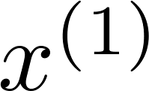
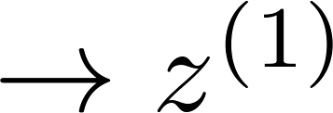
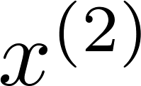
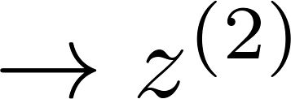
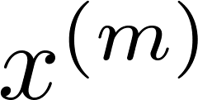
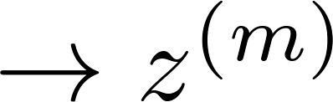

Data Compression
Reduce data from
2D to 1D
(inches)
(cm)
Notes:
Add more unique colors (3-4)

Slide 4
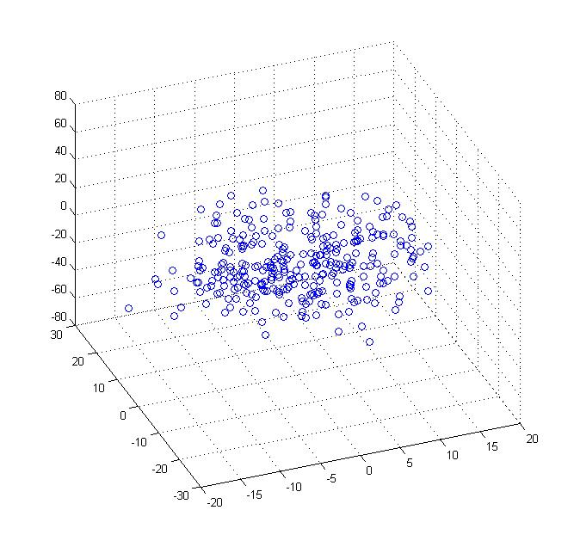
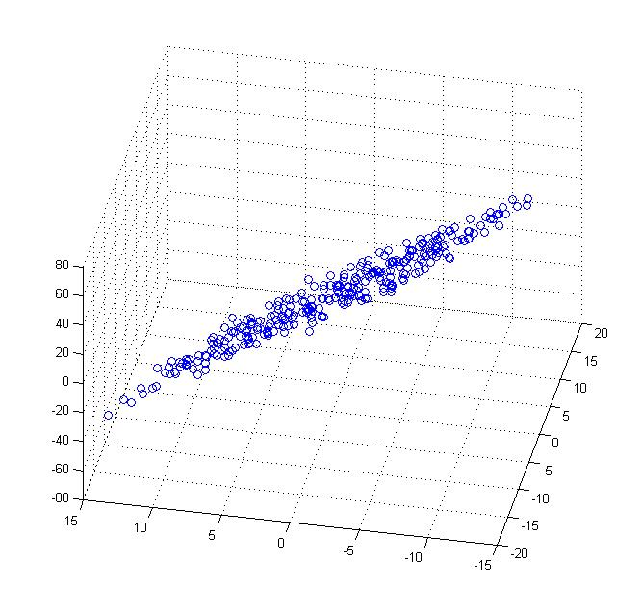
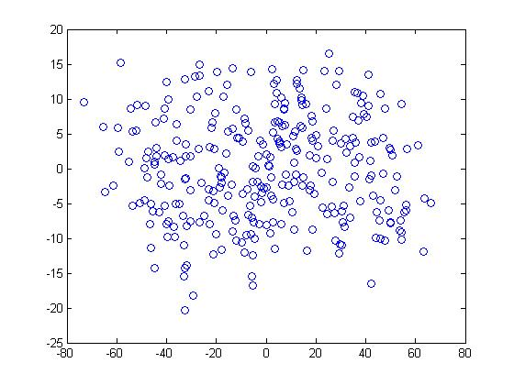


Data Compression
Reduce data from 3D to 2D
Notes:
Pca3d2d in lecture-slides/assets/pca/
Label axes

Slide 5
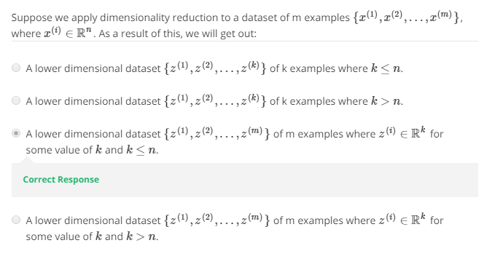

Slide 6
Motivation II: Data Visualization
Dimensionality Reduction
Machine Learning

Slide 7
Data Visualization
Country | GDP (trillions of US$) | Per capita GDP (thousands of intl. $) | Human Develop-ment Index | Life expectancy | Poverty Index (Gini as percentage) | Mean household income (thousands of US$) | …
Canada | 1.577 | 39.17 | 0.908 | 80.7 | 32.6 | 67.293 | …
China | 5.878 | 7.54 | 0.687 | 73 | 46.9 | 10.22 | …
India | 1.632 | 3.41 | 0.547 | 64.7 | 36.8 | 0.735 | …
Russia | 1.48 | 19.84 | 0.755 | 65.5 | 39.9 | 0.72 | …
Singapore | 0.223 | 56.69 | 0.866 | 80 | 42.5 | 67.1 | …
USA | 14.527 | 46.86 | 0.91 | 78.3 | 40.8 | 84.3 | …
… | … | … | … | … | … | …
[resources from en.wikipedia.org]
Notes:
Add dots

Slide 8
Data Visualization
Country
Canada | 1.6 | 1.2
China | 1.7 | 0.3
India | 1.6 | 0.2
Russia | 1.4 | 0.5
Singapore | 0.5 | 1.7
USA | 2 | 1.5
… | … | …

Slide 9
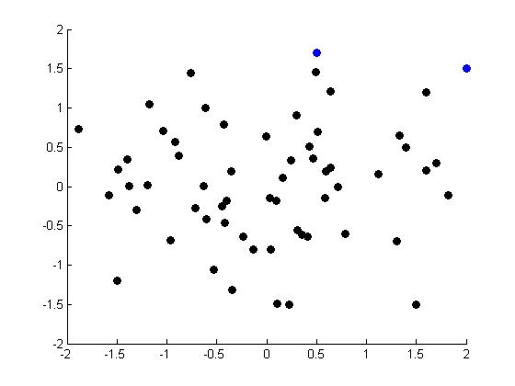
Data Visualization
Notes:
Make points look uncorrelated
US, Singapore in blue

Slide 10
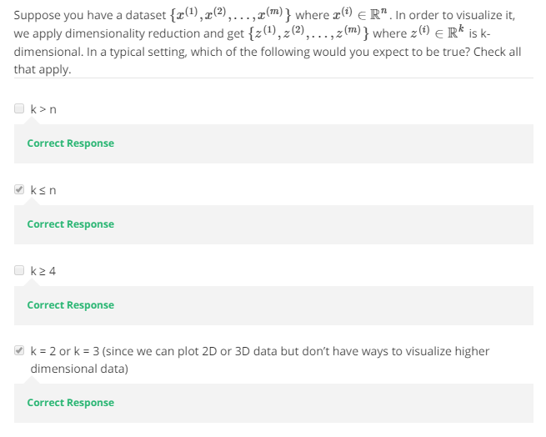

Slide 11
Principal Component Analysis problem formulation
Dimensionality Reduction
Machine Learning
(PCA is the generalized algo. that is used for dimensionality reduction)

Slide 12
Principal Component Analysis (PCA) problem formulation
(PCA tries to find a low dimensional hyperplane (projection
hyperplane) which has the minimum projection error)
Notes:
Change numbers to LATEX as well

Slide 13

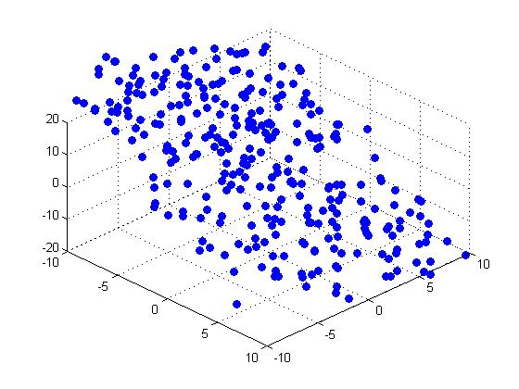


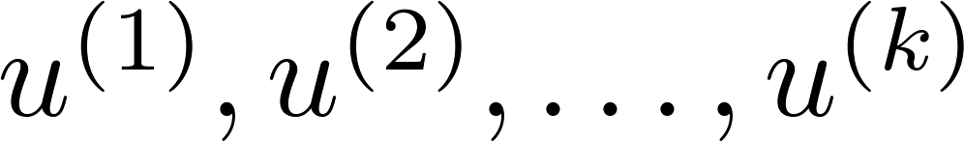
Principal Component Analysis (PCA) problem formulation
Reduce from 2-dimension to 1-dimension: Find a direction (a vector )
onto which to project the data so as to minimize the projection error.
Reduce from n-dimension to k-dimension: Find vectors
onto which to project the data, so as to minimize the projection error.
Notes:
Change numbers to LATEX as well

Slide 14
PCA is not linear regression
(PCA tries to minimize (squared) projection error not MSE)
Notes:
Add animation to block left graph

Slide 15
PCA is not linear regression
Notes:
Add animation to block left graph

Slide 16
Principal Component Analysis algorithm
Dimensionality Reduction
Machine Learning

Slide 17
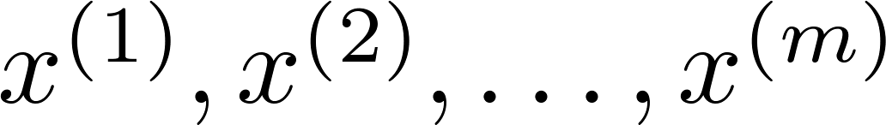
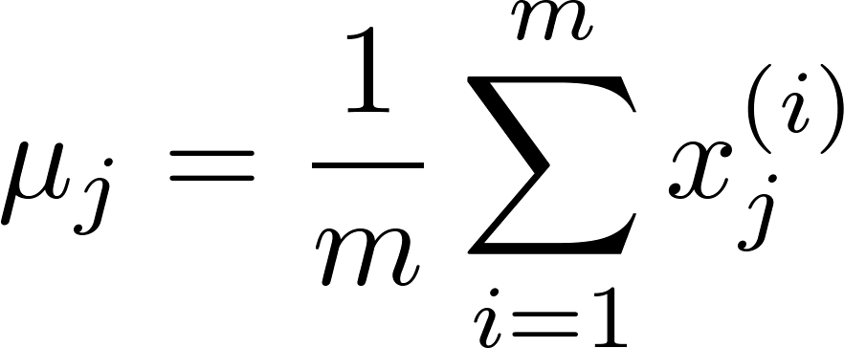
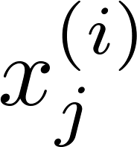



Data preprocessing
Training set:
Preprocessing (feature scaling/mean normalization):
Replace each with .
If different features on different scales (e.g., size of house,
number of bedrooms), scale features to have comparable range of values.
Notes:
Replace as previous; change spacing to fill page

Slide 18


Principal Component Analysis (PCA) algorithm
Reduce data from 2D to 1D
Reduce data from 3D to 2D
Notes:
Replace as previous; change spacing to fill page

Slide 19


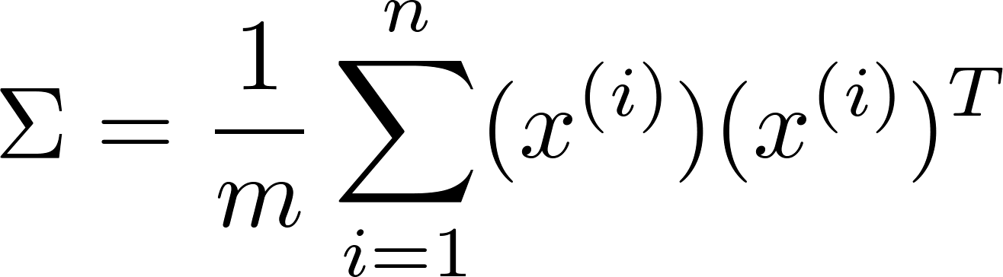

Symbol sigma representing covariance matrix
Principal Component Analysis (PCA) algorithm
Reduce data from -dimensions to -dimensions
Compute “covariance matrix”:
Compute “eigenvectors” of matrix :
[U,S,V] = svd(Sigma);

Slide 20
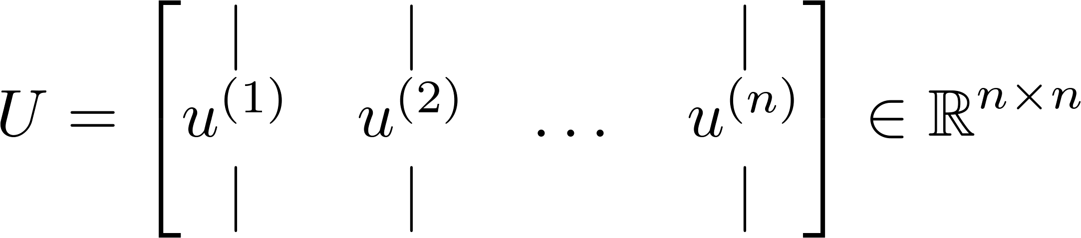
Principal Component Analysis (PCA) algorithm
From , we get:
[U,S,V] = svd(Sigma)

Slide 21
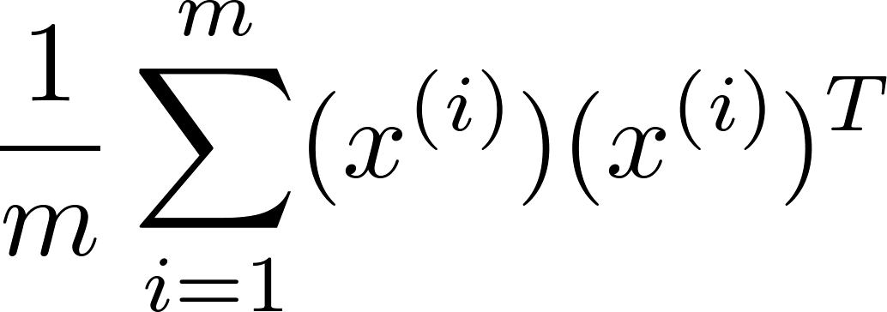
Principal Component Analysis (PCA) algorithm summary
After mean normalization (ensure every feature has zero mean) and optionally feature scaling:
Sigma =
[U,S,V] = svd(Sigma);
Ureduce = U(:,1:k);
z = Ureduce’*x;

Slide 22
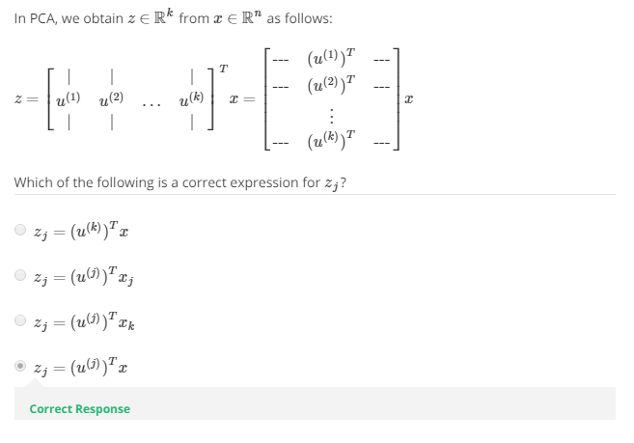

Slide 23
Reconstruction from compressed representation
Dimensionality Reduction
Machine Learning

Slide 24
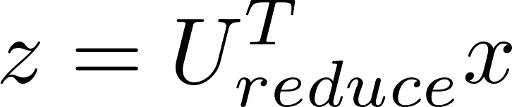
Reconstruction from compressed representation
Notes:
Make points have 0 mean on x1 and x2

Slide 25
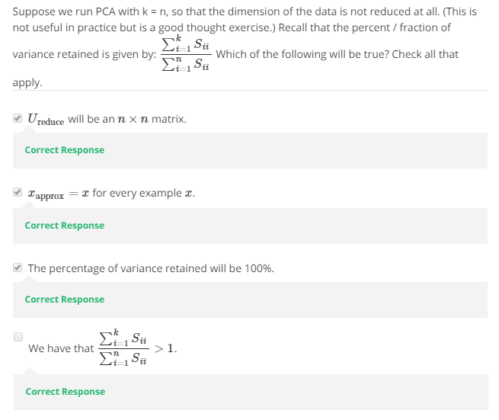

Slide 26
Choosing the number of principal components
Dimensionality Reduction
Machine Learning

Slide 27
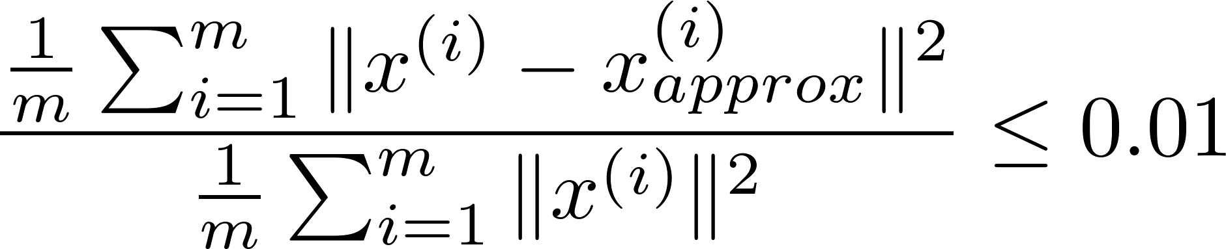
Choosing (number of principal components)
Average squared projection error:
Total variation in the data:
Typically, choose to be smallest value so that
“99% of variance is retained”
(1%)

Slide 28



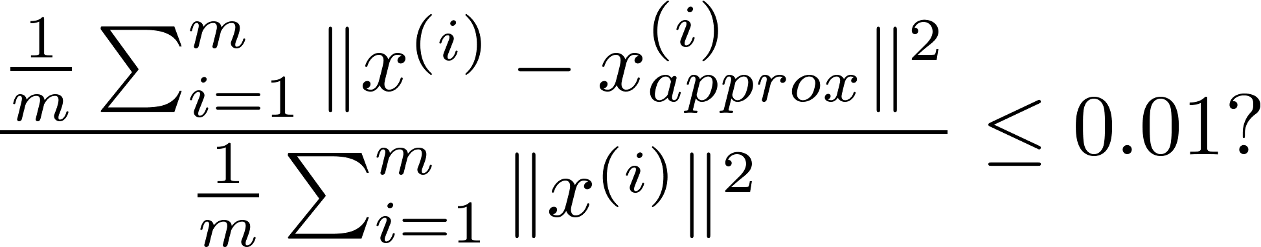
Choosing (number of principal components)
Algorithm:
Try PCA with
Compute
Check if
[U,S,V] = svd(Sigma)

Slide 29
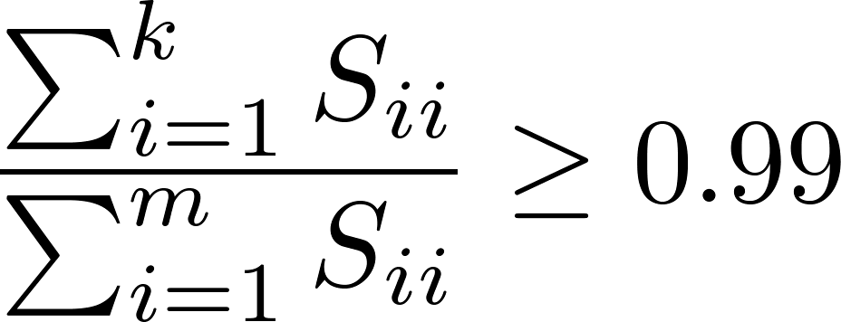
Choosing (number of principal components)
[U,S,V] = svd(Sigma)
Pick smallest value of for which
(99% of variance retained)

Slide 30
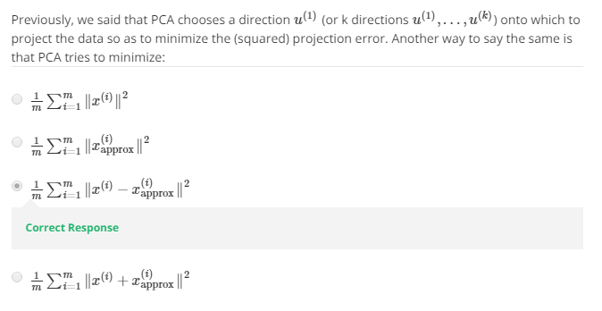

Slide 31
Advice for applying PCA
Dimensionality Reduction
Machine Learning

Slide 32

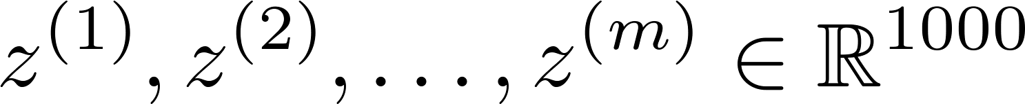
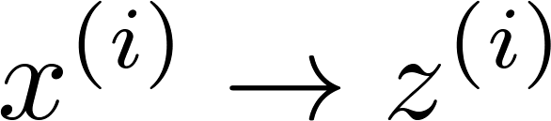
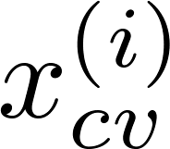
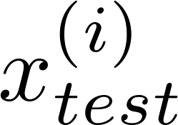
Supervised learning speedup
Extract inputs:
Unlabeled dataset:
New training set:
Note: Mapping should be defined by running PCA only on the training set. This mapping can be applied as well to the examples and in the cross validation and test sets.

Slide 33
Application of PCA
Compression
Reduce memory/disk needed to store data
Speed up learning algorithm
Visualization

Slide 34
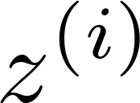
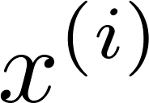

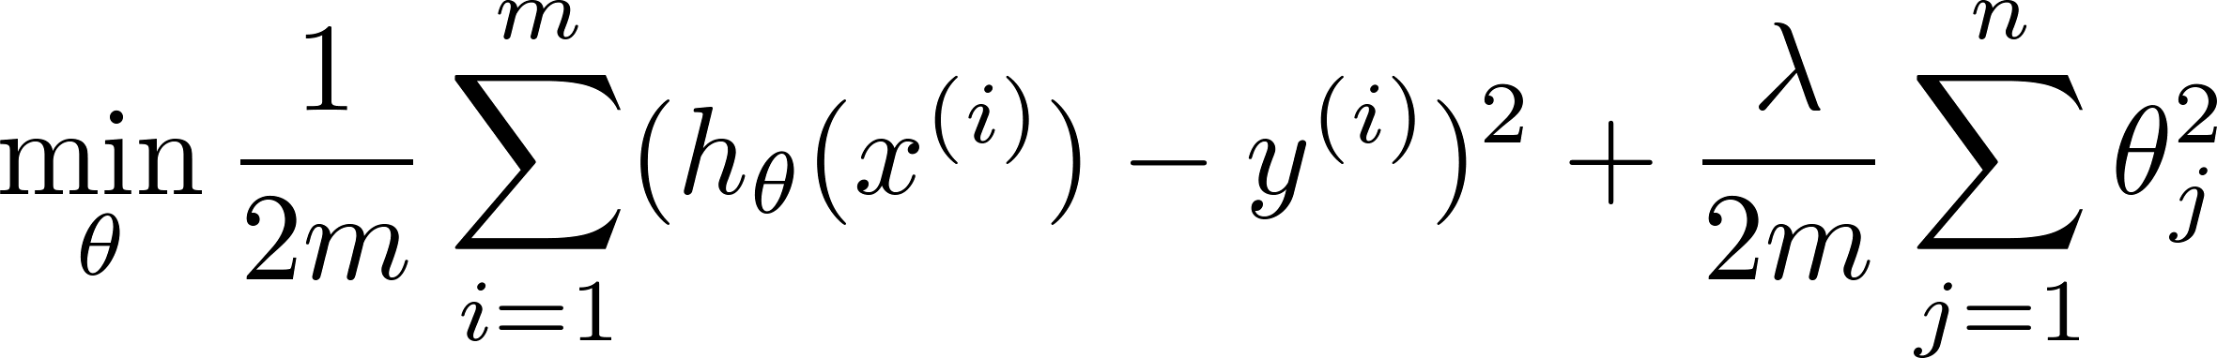
Bad use of PCA: To prevent overfitting
Use instead of to reduce the number of features to
Thus, fewer features, less likely to overfit.
This might work OK, but isn’t a good way to address overfitting. Use regularization instead.

Slide 35





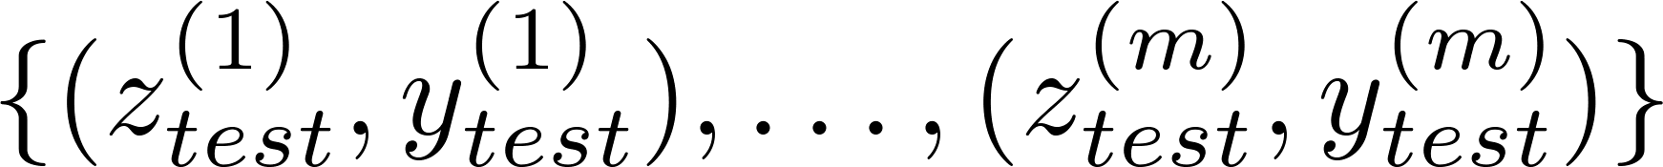
PCA is sometimes used where it shouldn’t be
Design of ML system:
Get training set
Run PCA to reduce in dimension to get
Train logistic regression on
Test on test set: Map to . Run on
How about doing the whole thing without using PCA?
Before implementing PCA, first try running whatever you want to do with the original/raw data . Only if that doesn’t do what you want, then implement PCA and consider using .

Slide 36
